Slide 1
竹女助教培訓
STL: Vector & Map ,
Object-Oriented Programming (1): Encapsulation
Ncurses Library ,linker
吳冠馨&潘翊嫻

Slide 2
First Part
STL:Vector&Map
OOP

Slide 3
What is STL?
Standard Template Library
The STL is a large collection of class templates and function templates provided with your native C++ compiler.
STL provides class templates that relieves you of the trouble of memory management.

Slide 4
STL
Today, we will focus on the Vector and Map in STL.
Before that, let's introduce the basics of STL—--- Templates.

Slide 5
Without Templates
*You will need to type similar
code multiple times.
// Maximum of ints
int max(const int x[],const size_t len)
{
int maximum = x[0] ;
for (size_t i=1; i < len; i++)
if(maximum < x[i])
maximum = x[i];
return maximum;
}
// Maximum of doubles
double max(const double x[], const size_t len)
{
double maximum = x[0] ;
for (size_t i=1; i < len; i++)
if(maximum < x[i])
maximum = x[i];
return maximum;
}

Slide 6
If you know how to use Templates
template <typename T>
T max (const T x[], int len)
{
T maximum = x[0] ;
for (size_t i = 1; i < len; i++)
if (maximum < x[i])
maximum = x[i];
return maximum;
}
The type for max isn't defined yet
*see a example

Slide 7
Vector

Slide 8
Vector
Containers are objects that you use to store and organize other objects.
an int vector – an array of integers
a string vector – an array of strings
Class template vector (vector<T>) :
vector<string> strings;
vector<double> data;
vector <int>mydata;

Slide 9
Vector
vector<int> mydata(100);
Create a vector that contains 100 elements that are all initialized to zero .
vector<int> mydata(100, -1);
Create a vector that contains 100 elements that are all initialized to -1.

Slide 10
Vector
***[begin, end) ***
0 1 2 3 4 5 6 7 8 9
int data[ ] = { 1, 2, 3, 4, 5, 6, 7, 8, 9, 10 };
vector mydata(data, data+8); // mydata will contain 1 2 3 4 5 6 7 8
vector hisdata(mydata.begin()+1, mydata.end()-1); // hisdata will contain 2 3 4 5 6 7
0 8
0 1 2 3 4 5 6 7 8
0 1 8 7
The virtual empty slot at the back

Slide 11
Iterator
#include <iostream>
#include <vector>
int main() {
std::vector<int> v = {10, 20, 30};
for (std::vector<int>::iterator it = v.begin(); it != v.end(); ++it) {
std::cout << *it << " ";
}
return 0;
}
replace with auto it
get the value
*try

Slide 12
Capacity and Size of a Vector Container
capacity()– the maximum number of objects a container can currently accommodate.
size()– the number of objects stored in the container.
empty()– Boolean function which tests whether size() is 0.

Slide 13
Resize
vector values(5, 66); // 66 66 66 66 66
values.resize(7,88); // 66 66 66 66 66 88 88
values.resize(10); // 66 66 66 66 66 88 88 0 0 0
// If you don’t specify a value for new elements,
// the default value of the object will be produced.
values.resize(4); // 66 66 66 66
Notes:
int main() {
vector<int> values(5, 66);
for (size_t i = 0; i < values.size(); ++i) {
std::cout << values[i] << " ";
}
return 0;
}

Slide 14
Accessing Elements in a Vector
cout << [i]; //The name of your vector container
Use the at(i) function where the argument is the index position.
cout << .at(i);
front()
The first element
back()
The last element
this one is safer

Slide 15
Inserting and Deleting Elements in a Vector
vector<int> mydata;
mydata.push_back(99); 99 will be added at the end
If you add new elements to this vector, the memory allocated for the vector will be increased automatically .
mydata.pop_back(); The last element will be deleted.
pop_back() does not take any arguments; it modifies the container in place .

Slide 16
Inserting and Deleting Elements in a Vector
clear();
the size will be 0; the capacity will be left unchanged.
insert(position, value);
erase(position);
Both the erase() and insert() operations are slow.
Notes:
slow :因為如果資料很多需要集體移動，很費時

Slide 17
Sorting Vector Elements
sort(data, data+count); From small to large
Note the pointer marking the end of the sequence of elements
must be one past the last element.
sort(data, data+count, greater()); From large to small
Sorting in descending order.
Remember to “using std::greater”
*see example

Slide 18
Exercise
Write a function to process the input student grades in the following two steps:
1.If the number of students in this class is fewer than 5, please expand the vector to a size of 5 and fill the remaining slots with the default passing score of 60.
2.If the last element of the scores is less than 60 , remove that element directly(If the size is less than 5 after the deduction, there is no need to add 60).
resize()
pop_back()
empty()
*int s : classScores*
Notes:
int main() {
std::vector<int> classScores = {85, 90, 45};
processScores(classScores);
for (int s : classScores) std::cout << s << " ";
std::cout << "\n";
std::vector<int> classScores2 = {70, 80, 90, 85, 55};
processScores(classScores2);
for (int s : classScores2) std::cout << s << " ";
return 0;
}

Slide 19
Map

Slide 20
Map
map <K , T>
K Key
T Object(value)
Pair
The objects you store in a map are always a key/object pair.

Slide 21
Map
Keanu
Reeves
Keanu
Keanu
Reeves
Pair | 1 | 2 |
Key | Keanu|Reeves|
Object | 3 | 2 |

Slide 22
Map
int main() {
map <string, int> score;
score["Alice"] = 100;
score["Bob"] = 70;
score["Charlie"] = 60;
cout << score["Bob"] << endl;
cout << score.size() << endl;
return 0;
}
*try

Slide 23
Insert Elements into a Map
int main() {
map ages; ages["Alice"] = 25;
pair b = {"Bob", 30 };
ages.insert(b);
ages.insert( pair("Charlie", 35) );
for (auto p : ages) {
cout << p.first << '\t' << p.second << endl;
}
return 0;
}
*see example

Slide 24
Map
Akee Breadfruit Cherry
Dragonfruit Elderberry
int main() {
string fruit;
map<string, int> fruit_count;
while (cin >> fruit) {
fruit_count[fruit]++;
}
for (const auto& kv : fruit_count) {
cout << kv.first << '\t' << kv.second << endl;
}
return 0;
}
*try

Slide 25
count_if
bool retired(const pair<string, int>& p) {
return p.second > 65;
}
int main() {
map <string, int>ages;
ages["Alice"] = 50;
ages["Bob"] = 60;
ages["Carol"] = 70;
ages["Daniel"] = 80;
ages["Emily"] = 90;
cout << count_if(ages.begin(), ages.end(), retired);
return 0;
}
*try

Slide 26
copy() and copy_if()
using std::ostream_iterator;
bool passed(int n) { return n >= 60; }
int main() {
int a[10] = {17, 49, 19, 32, 10, 68, 95, 57, 21, 85};
vector<int> b(10);
vector <int> c(10);
ostream_iterator<int> output( cout, " " );
copy(a, a+10, b.begin());
copy_if(a, a+10, c.begin(), passed);
copy(b.begin(), b.end(), output); cout<< '\n'; copy(c.begin(), c.end(), output); cout<< '\n';
}
*try

Slide 27
Exercise
Please write a simple function called `getPrice`
that looks up and returns the price of a fruit when a enters its name
*apple orange*
map
string
Notes:
int main() {
int applePrice = getPrice("apple");
std::cout << "蘋果的價格是: " << applePrice << " 元\n";
int orangePrice = getPrice("orange");
std::cout << "橘子的價格是: " << orangePrice << " 元\n";
return 0;
}

Slide 28
OOP

Slide 29
Why do we need it ?
Data Protection (Security):
It prevents direct and unauthorized modification of data.
Complexity Reduction:
Users do not need to understand the internal mechanics to use the object.
Easier Maintenance:
Easy to upgrade the program without causing errors.

Slide 30
OOP
Class A class is a (user-defined) data type in C++. It can contain data elements of basic types in C++, or of other user-defined types.
Object An object provides more advanced features:
Encapsulation – an object contains data and functions that operate on those data.

Slide 31
OOP
Internal（ Private)：Cannot be changed at will.
External（ Public)：Use simple commands.

Slide 32
Member Functions
class CRational {
public:
int m_numerator;
int m_denominator;
void Print() { //Member Function
cout << m_numerator << '/' << m_denominator << endl;
}
};
int main() {
CRational a1;
a1.m_numerator = 1;
a1.m_denominator = 2;
a1.Print();
return 0;
}

Slide 33
Class Constructors
A class constructor is a special function which is invoked when a new object of the class is created
It always has the same name as the class.
It has no return type.
class CRational {
private:
int m_numerator;
int m_denominator;
public:
CRational(int n, int d) {
m_numerator = n;
m_denominator = d;
}
};
Notes:
class CRational {
private:
int m_numerator;
int m_denominator;
public:
CRational(int n, int d) {
m_numerator = n;
m_denominator = d;
}
};

Slide 34
Constructor
Default Constructor : If you do not write any constructors at all, the compiler will automatically generate a parameterless default constructor for you.
Initialization List : CRational::CRational(int n, int d) : m_numerator(n), m_denominator(d) { ... }
Copy Constructor : It is called when initializing a new object using an existing object.（ CRational b = a;）
*see example

Slide 35
Second Part
NCURSES Library, Linker

Slide 36
NCURSES Library

Slide 37
What is NCURSES Library?
ncurses (new curses) is
a programming library for creating textual user interfaces (TUIs) that work across a wide variety of terminals.

Slide 38
Initialize and Terminate Curses
initscr()
endwin()
refresh()
Initializes the screen
Exits ncurses mode
Frees up memory
This function will be called when your program is finished
Update the screen

Slide 39
Basis Functions
move(y, x)
addch(ch)
addstr(str)
printw(fmt, arg1, arg2, …)
Move cursor to (y, x) in the screen
Add a character to screen
Add a string to screen
Formatted print to screen like printf()

Slide 40
Getting Characters from the Terminal
getch()
getstr(str)
scanw(fmt, arg1, arg2)
Get a character from the terminal
Get a string from the terminal
Formatted input from the terminal like scanf()

Slide 41
curses-1.cpp
#include <Windows.h>
#include <curses.h>
int main() {
// TODO 1: Initialize the screen
// TODO 2: Move to (y=5, x=10) and print a star '*'
// TODO 3: Update the screen
// TODO 4: End the NCURSES mode
return 0;
}

Slide 42
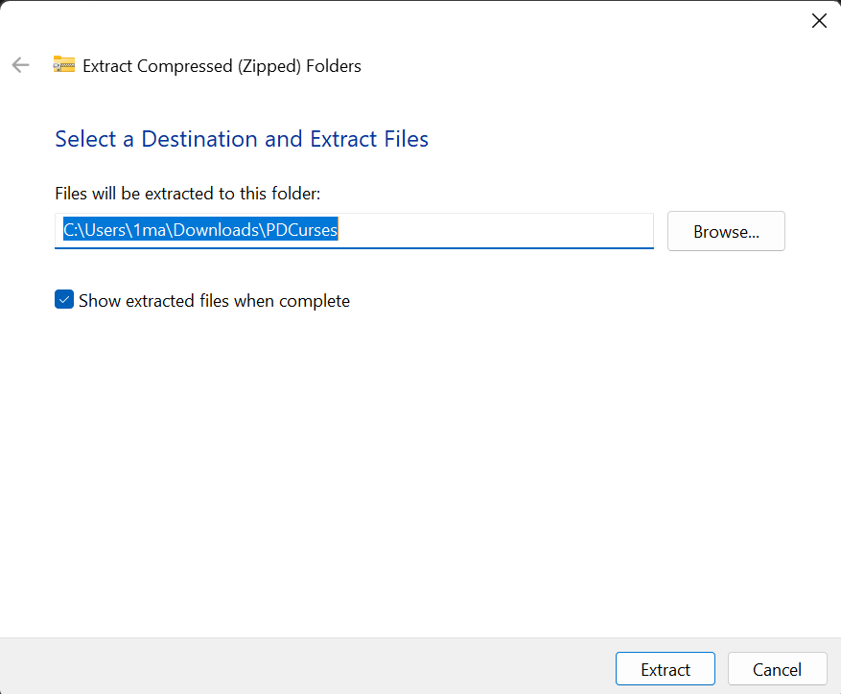
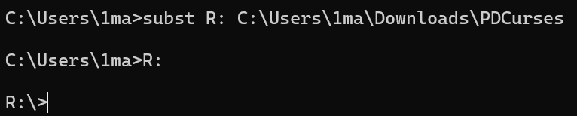
Use Curses Library
Download Public Domain Curses Library
Create Virtual Disk

Slide 43
x86 Native Tools Command Prompts
"C:\Program Files\Microsoft Visual Studio\2022\Community\VC\Auxiliary\Build\vcvars32.bat"
CL /c curses-1.cpp /I R:\PDCurses
LINK curses-1.obj R:\PDCurses\pdcurses.lib
SET PATH=R:\PDCurses;%PATH%
curses_1.exe

Slide 44
Controlling Display: noecho() and curs_set()
noecho()
curs_set()
Hide keyboard input from the screen
Keep the terminal UI clean
curs_set(0) : Hides the cursor completely
curs_set(1) : Shows a standard blinking underline
curs_set(2) : Shows a solid block cursor

Slide 45
curses-2.cpp
#include <Windows.h>
#include <curses.h>
int main() {
initscr();
// TODO 1: Disable automatic echoing of input characters
// TODO 2: Hide the cursor
move(2, 5);
printw("The cursor is now hidden, and your input won't be echoed.");
refresh();
getch();
endwin();
return 0;
}

Slide 46
Why We Need keypad()
getch()
only understands basic characters (like 'a' or '1')
Special keys (like arrow keys) send complex character sequences that are hard for the program to read

Slide 47
Function Keys
The keypad() function :
Enables the terminal to translate special key sequences into readable constants
Syntax: int keypad(WINDOW *win, bool bf);
Example: keypad(stdscr, TRUE);

Slide 48
Common Key Definitions
Arrow Keys
Function Keys
Navigation
KEY_UP, KEY_DOWN, KEY_LEFT, KEY_RIGHT
KEY_F(n)
KEY_HOME, KEY_END,
KEY_PPAGE (PageUp), KEY_NPAGE (PageDown)

Slide 49
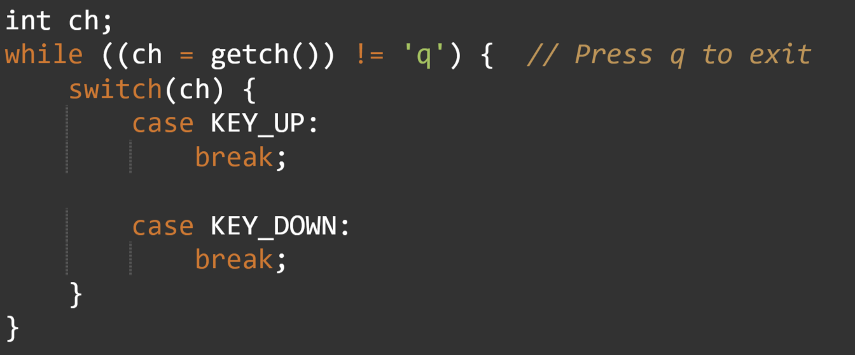
Code Example

Slide 50
curses-3.cpp
#include <Windows.h>
#include <curses.h>
int main() {
initscr();
// TODO 1: Enable keypad mode for stdscr
printw("Use arrow keys to move, press 'q' to quit.\n");
refresh();
int ch;
while((ch = getch()) != 'q') {
switch(ch) {
case KEY_UP:
break;
// TODO 2: Add cases for other arrow keys here
}
refresh();
}
endwin();
return 0;
}

Slide 51
timeout()
Controls the time your program waits for user input
Affects the behaviour of getch() when reading a character from stdscr
The delay time is measured in milliseconds
(1000ms = 1 second)
Syntax: timeout(int delay);

Slide 52
timeout()
Time Limit:
Forces getch() to wait only for a specified duration (e.g., 500ms)
If a Key is Pressed:
Stops waiting immediately and returns the pressed character
If NO Key is Pressed (Timeout):
Returns ERR (-1) and forces the program to continue execution

Slide 53
curses-4.cpp
#include <Windows.h>
#include <curses.h>
int main() {
initscr();
// TODO 1: Set input delay to 500ms (program will run every 0.5s)
int counter = 0;
while(1) {
move(5, 5);
printw("Auto-updating counter: %d", counter++);
refresh();
if(getch() == 'q') break; // Exit on 'q'
}
endwin();
return 0;
}

Slide 54
Initializing the Color System
Step 1: Call start_color()
Step 2: Check Compatibility
Use has_colors() to checks whether the terminal supports color display, it returns TRUE or FALSE

Slide 55
Initializing the Color System
Initialization init_pair()
Syntax: init_pair(pair_number, foreground, background)
Example: init_pair(1, COLOR_WHITE, COLOR_RED)
(White text on Red background)
Usage: After initialization, use COLOR_PAIR(n) to apply it.

Slide 56
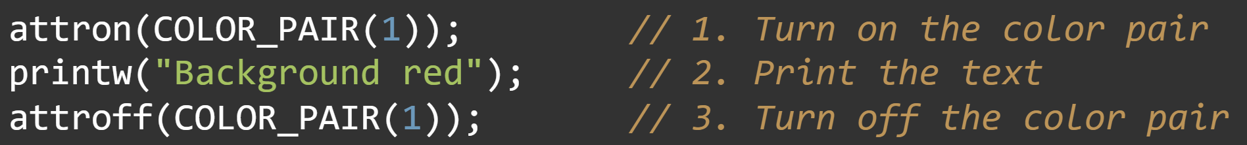
Applying Colors
Turning attributes ON and OFF:
Use attron() before printing, and attroff() after printing

Slide 57
curses-5.cpp
#include <Windows.h>
#include <curses.h>
int main() {
initscr();
// TODO 1: Start color mode
// TODO 2: Initialize color pair 1 (Foreground: Red, Background: Black)
// TODO 3: Print a message using color pair 1
refresh();
getch();
endwin();
return 0;
}

Slide 58
Linker

Slide 59
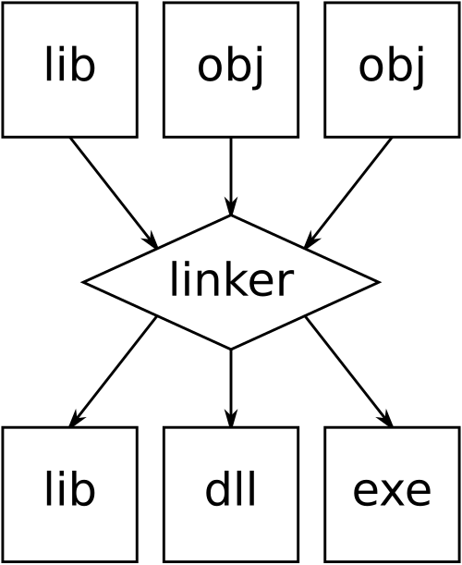
What is Linker?
It takes individual compiled files (.o) and merges them into one final executable
It maps your function calls (like initscr()) to their actual locations in external libraries

Slide 60
Why do we need a Linker?
Modularity: Allows large programs to be split into small, manageable files.
Efficiency: Only changed files need to be recompiled; the linker then quickly updates the rest.
Code Reuse: You can use powerful libraries (like ncurses) without ever needing to see or rewrite their complex source code.
Relocation: It organizes scattered code chunks into a single, cohesive memory layout so the computer can run it.

Slide 61
References
Professor Quincy Wu brief report
https://moodle.ncnu.edu.tw/mod/resource/view.php?id=67522
https://moodle.ncnu.edu.tw/pluginfile.php/128357/mod_resource/content/1/week04-oop.pdf
https://moodle.ncnu.edu.tw/pluginfile.php/128358/mod_resource/content/1/ncurses.pdf
gemini

Slide 62
Q&A

